Slide 1
Dataset Analysis Report of Call Center Data Oct. 2020
By Christopher O. Okoro, Data Analyst

Slide 2
Introduction
The following report presents the findings of the exploratory data analysis (EDA) conducted on a Call Centre Dataset for October 2020. The dataset contains information about customer interactions, customer satisfaction, and call centre operations. The EDA was carried out using Microsoft Excel, and the insights were visualized on an interactive dashboard.

Slide 3
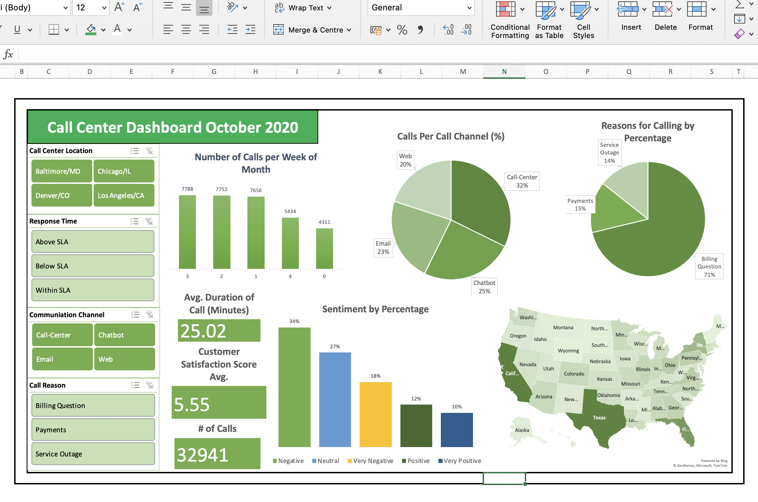
Dashboard
Interactive dashboard for October 2020 Call Centre dataset

Slide 4
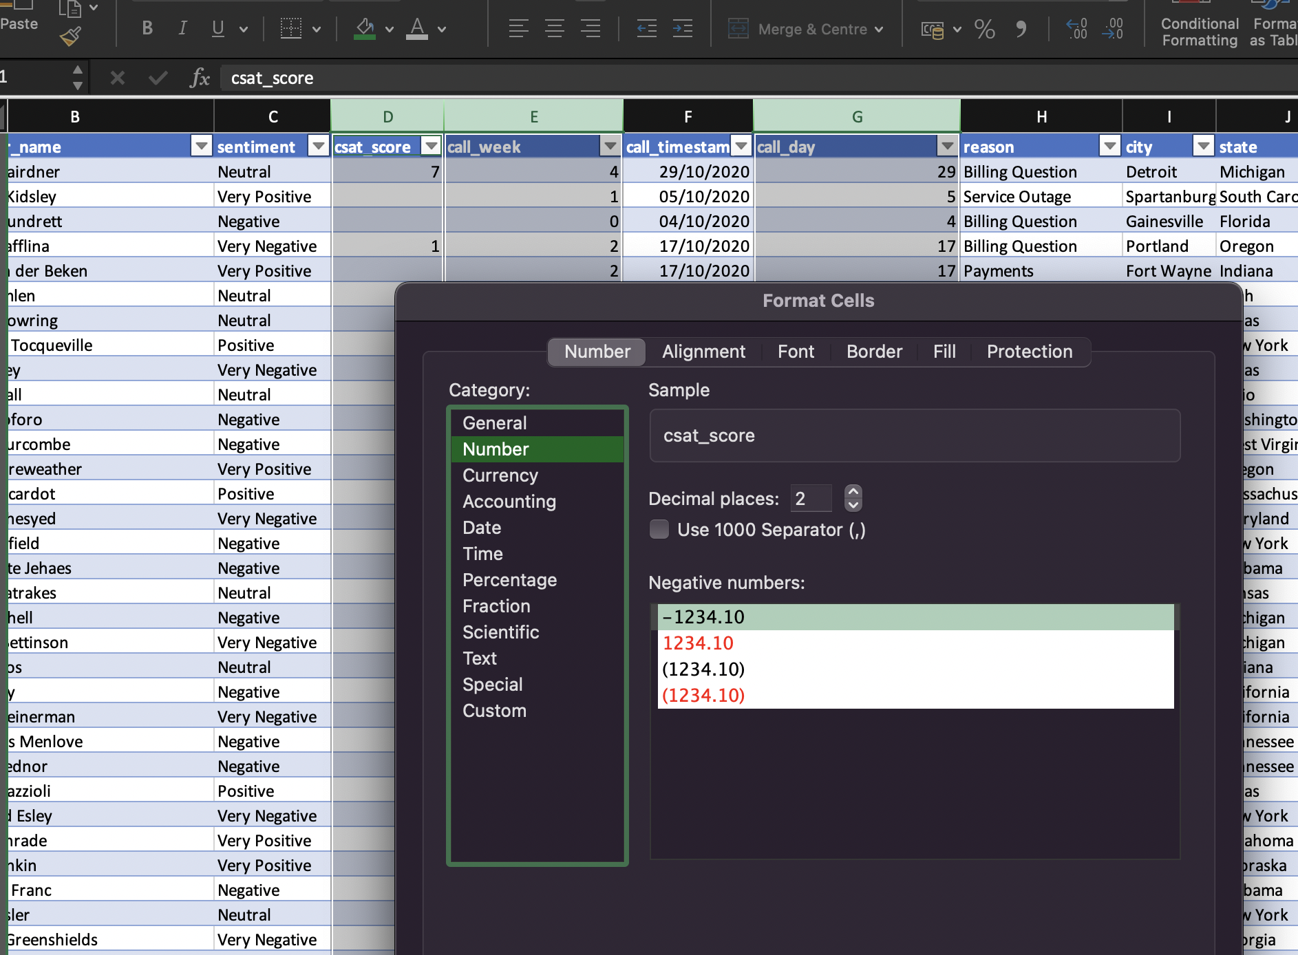
Data Cleaning
During the data cleaning process, missing values were found in the csat_score column only. The column formats were adjusted, call timestamp was changed to date type, and the columns with numeric data type were changed to number data type accordingly. The dataset was prepared for analysis by ensuring data integrity and accuracy. Total of 32941 rows of data was used for analysis.

Slide 5
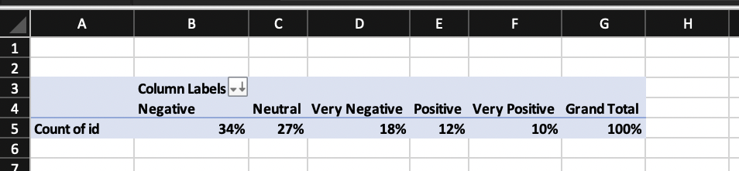
Customer Sentiment Analysis
The analysis of customer sentiment revealed that most calls had a negative (34%) or neutral sentiment (27%), while very negative, positive and very positive sentiments constituted 18%, 12% and 10%, respectively. The call centre should focus on enhancing customer satisfaction by addressing issues that lead to negative sentiments. Pivot table shown below.

Slide 6
Customer Satisfaction Score
As this column had some missing values, an average was done as this has a lesser effect due to missing data. The average customer satisfaction score was calculated to be 5.5 out of 10. This indicates a slightly above average level of customer satisfaction with the call centre services. Efforts should be made to improve customer satisfaction levels.

Slide 7
Call Centre Performance
Call centre performance was assessed based on response times, call durations, and customer satisfaction scores. Some call centres demonstrated consistently fast response times and high customer satisfaction scores, while others required improvement. Denver/CO had the best customer satisfaction score and least average call duration within the SLA Response time. Training and support could be provided to enhance the performance of less experienced employees in the call centres.

Slide 8
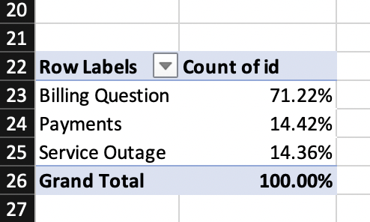
Reasons for Call
The most common reasons for calls included billing questions (71%), payments (15%), and service outage (14%). Understanding these trends can help the call centre prioritize and optimize resources to better address customer needs. Pivot table shown below.

Slide 9
Call Communication Channel
Call Centre was the most widely used communication channel (32%), followed by chatbot (25%), email (23%) and web (20%). The call centre should evaluate the effectiveness of different channels and ensure appropriate resources are allocated accordingly.

Slide 10
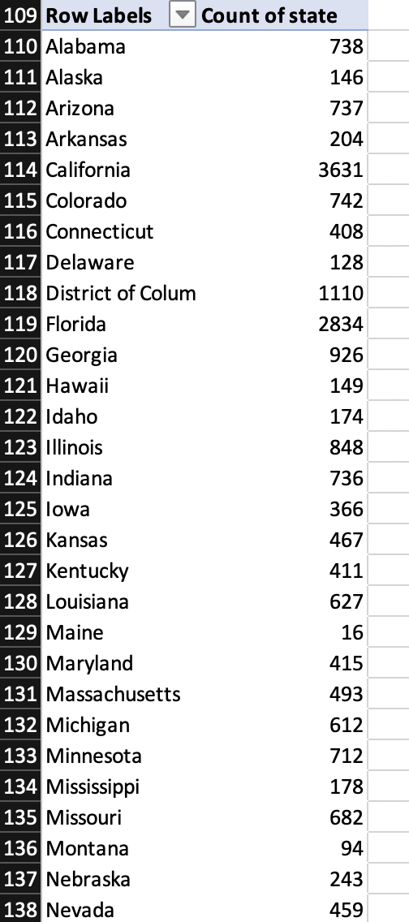
Geographic Analysis
Geographically, the majority of calls originated from California, Texas, and Florida as shown in the dashboard. This information can be valuable for resource allocation and identifying regions where additional support might be required. Pivot table shown.

Slide 11
Recommendations
Focus on addressing issues leading to negative customer sentiment to improve overall customer satisfaction.
Provide training and support to employees with lower performance scores to enhance their efficiency.
Prioritize resources based on the most common reasons for calls to ensure effective support.
Evaluate the effectiveness of different call channels and optimize their usage.
Monitor call centre performance in different geographic regions to provide tailored support and services.

Slide 12
Conclusion
The analysis of the Call Centre Dataset for October 2020 revealed valuable insights into customer sentiment, call centre performance, call centre efficiency, and customer behaviour. The analysis highlighted areas of improvement and potential opportunities for enhancing customer satisfaction and optimizing call centre operations. The interactive dashboard facilitated data exploration and presented information in a visually appealing and easily understandable manner.

Slide 13
Thank You for reading..

